Slide 1
NASA INTERNATIONAL SPACE APPS CHALLENGE 2022

Slide 2
The Challenge
Imagine you’re an astronaut who has newly arrived on the red planet. Your habitat has been pre-constructed for you, but, other than three 3-D printers, it doesn’t have most of the things you need to live and work. Your challenge is to design tools, furniture, and other items to assist you on your one-year mission.

Slide 3
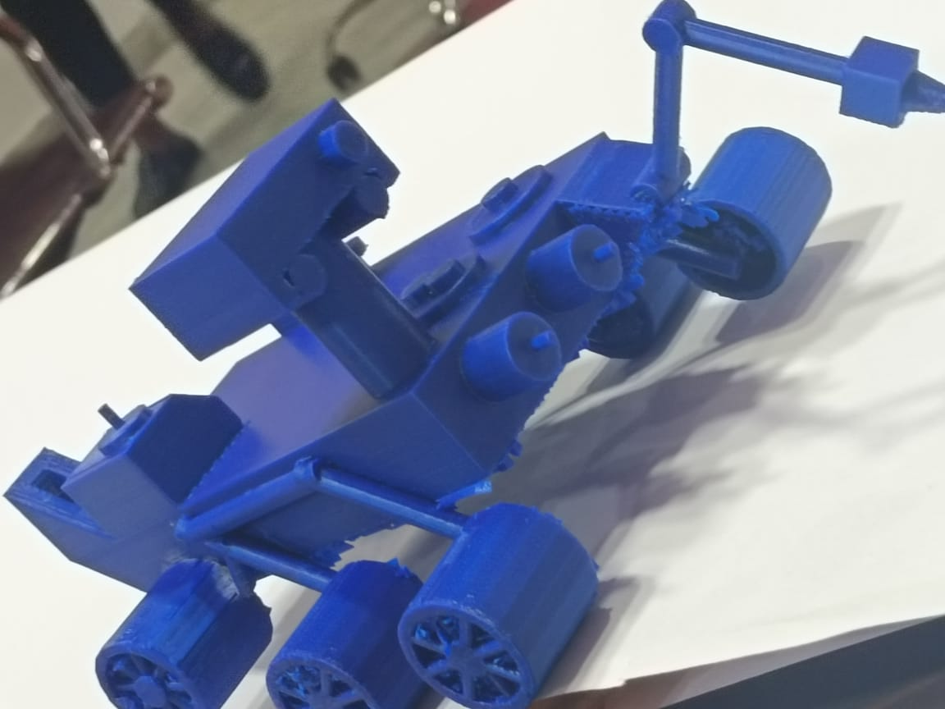

Slide 4
Main Job : To detect moisture content in soil and water availability.
3D Model dimensions
Length : 23.6 cm
Width : 16.5 cm
Height : 10.8 cm
Weight / Mass : 1.1 pounds / 0.5 kilograms
Original dimensions
Length : 10 feet (3 meters)
Width : 9 feet (2.7 meters)
Height : 7 feet (2.2 meters)
Weight / Mass : 2,260 pounds / 1,025 kilograms

Slide 5
Components :
Navigation Camera
Soil moisture sensor
Arduino UNO
Solar panels
Wire mesh
Arm robot using Arduino
Soil driller

Slide 6
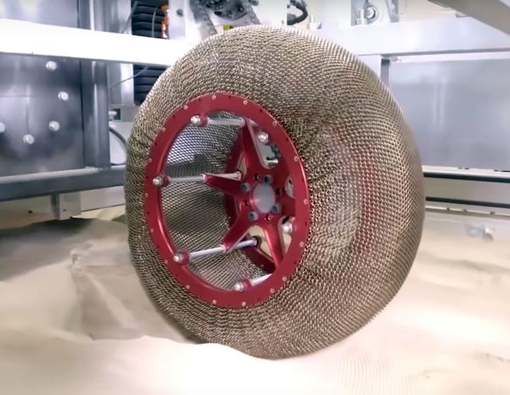
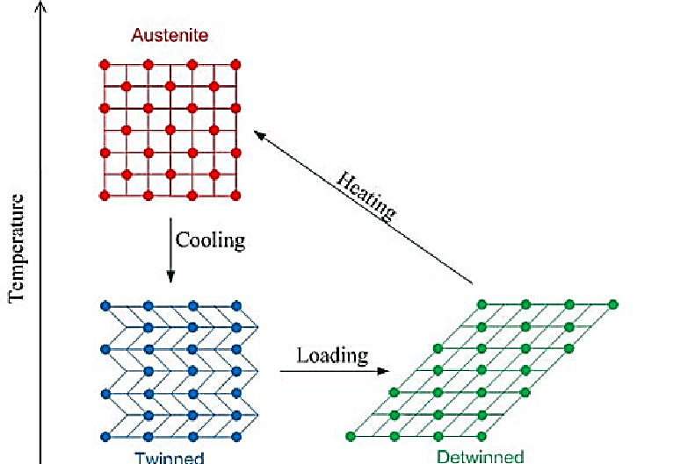
SHAPE MEMORY ALLOY (Cu + Al + Zn) :
It is a material which expands at high temperature and takes it’s original form at low temperature.

Slide 7
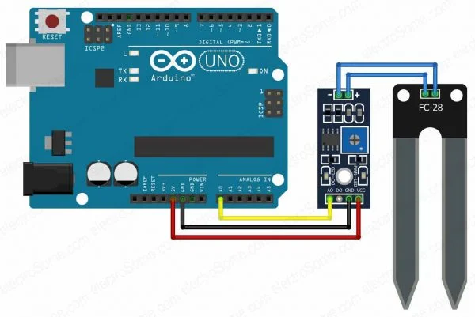
SOIL MOISTURE SENSOR

Slide 8
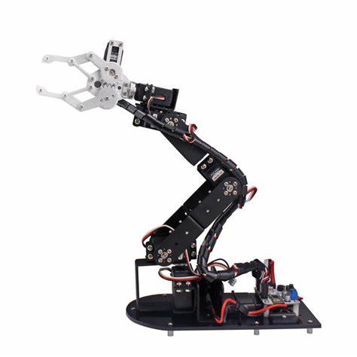
ARM ROBOT

